Slide 1
Load Balancer
Load balancing means distribution of load across the distributed systems.
Eg: Computers, clusters, networks, etc.
Dedicated Hardware and Software.
Optimize resources use
Maximize throughput
Minimize response time
Avoid overload
WHY?
No single point of failure
Higher reliability

Slide 2
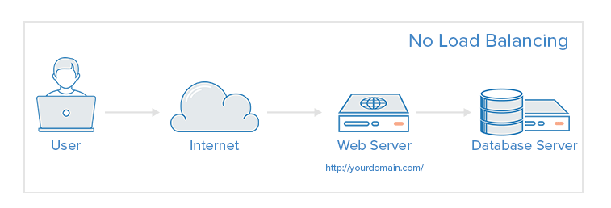
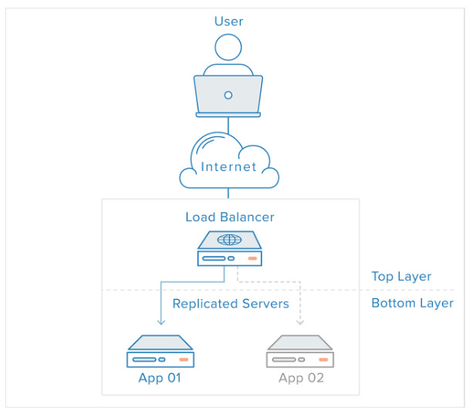
Web infrastructure with no load
balancing
With load balancing

Slide 3
Types of load balancers
Hardware load balancers – device between client and server to balance the load
Layer 4 Hardware load balancing
uses information defined at the networking transport layer (Layer 4) as the basis for deciding how to distribute client requests across a group of servers.
For Internet traffic specifically, it bases the load-balancing decision on the source and destination IP addresses and ports recorded in the packet header, without considering the contents of the packet.

Slide 4
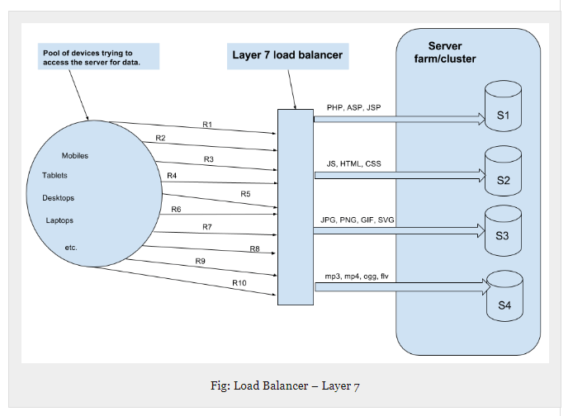
Layer 7 Hardware load balancing
makes the decision according to the actual content of the message (URLs, cookies, scripts)
For example, the request for image will go to an image server, request for PHP scripts may go to another server

Slide 5
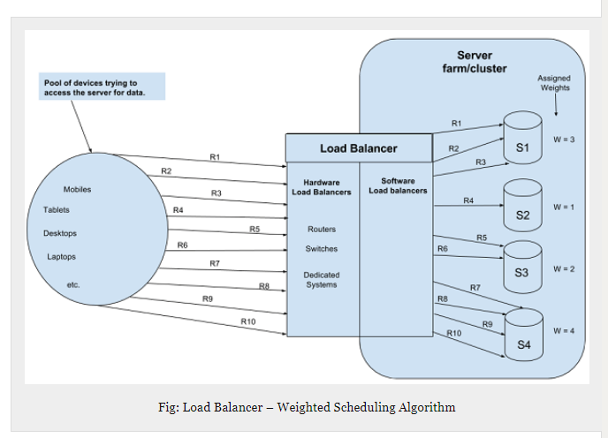
Types of load balancers
Software load balancers – implements a combination of scheduling algorithms
Weighted scheduling algorithms
Traffic sent to a server according to weight assigned to it. Weight determined according to hardware capabilities

Slide 6
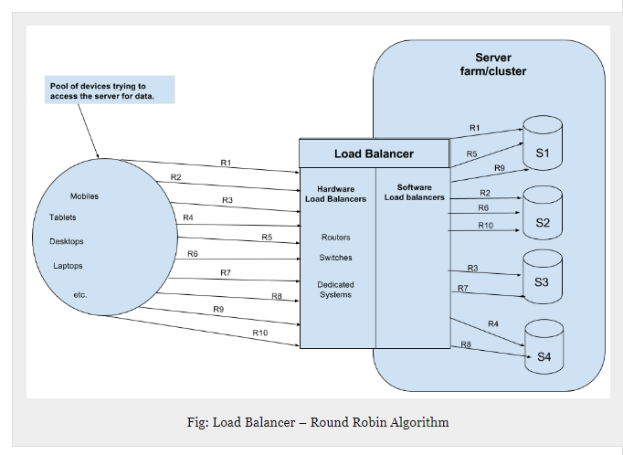
Round robin scheduling
Requests are served by servers sequentially

Slide 7
Least connection first scheduling
Request served first to server currently handling least number of persistent connections

Slide 8
Examples of load balancers
Hardware based
F5 BIG-IP Local Traffic Manager
Cisco Load balancer
Barracuda Load balancer
Coyote point
Software based
Resonate central dispatch
Zen load balancer
NGINX Plus

Slide 9
How to select/choose load balancers?
How to define the basic requirements for Load Balancing solution?
When would an LB be most useful?
Reference: https://kemptechnologies.com/load-balancing/four-questions-help-you-decide-load-balancing-solution/

Slide 10
How to define the basic requirements for Load Balancing solution?
What are the applications that require highly available application delivery?
How much traffic is generated by the applications for which the Load Balancer will service?
How many application requests are received during peak utilization?
Are there any special requirements for content manipulation, data caching, data compression or SSL handling?

Slide 11
When would an LB be most useful?
If you have two or more redundant application servers in your environment
If you want to architect an application solution that is easily scalable
If you want to architect an application solution that is highly available

Slide 12
What security features do you need with your Load Balancers?
Content Switching
SSL Acceleration
Data Compression
Data Caching
Intrusion Prevention
Single Sign-On
Pre-Authentication

Slide 13
References
https://www.serverwatch.com/server-tutorials/slideshows/11-load-balancers-you-need-to-know-in-2016.html
http://www.thegeekstuff.com/2016/01/load-balancer-intro/
https://www.digitalocean.com/community/tutorials/what-is-load-balancing
https://www.nginx.com/resources/glossary/layer-4-load-balancing/

Slide 14
Thank you!
Any Questions?

